Slide 1



Sine Die
57th Legislature – Second Regular Session
July 24, 2026
Presented By:
Damien Johnson
Director of Government Relations
Notes:
1

Slide 2
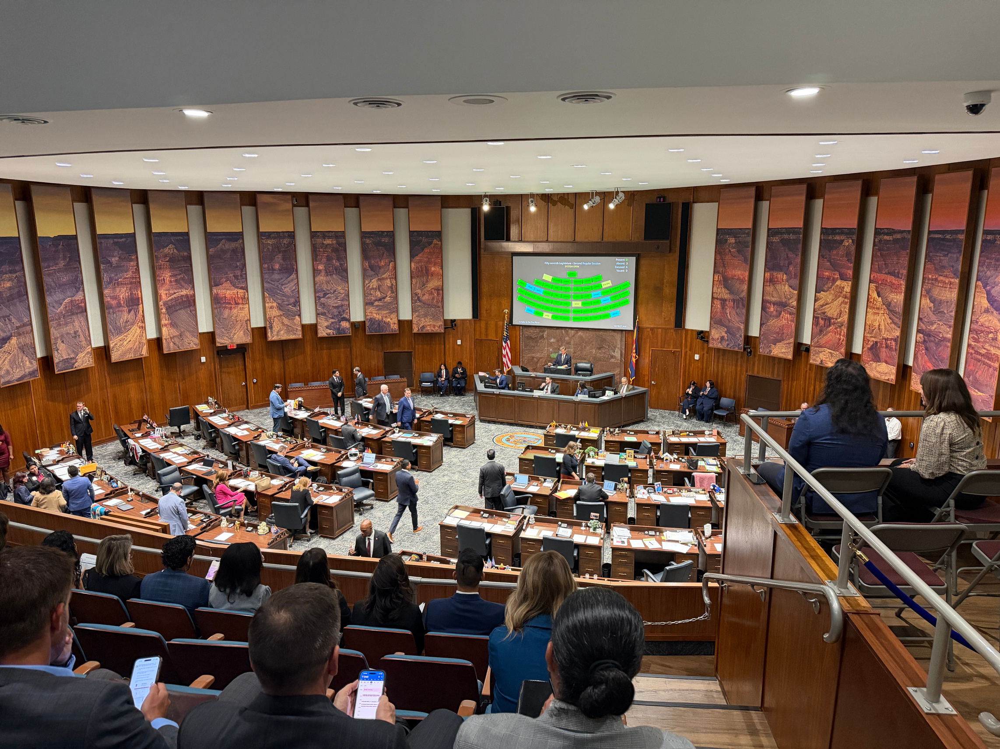
Quick Recap of 2025 Policy

Slide 3
2025 Policy Implementation
HB2175 prior authorization; claims
  Requires the health insurer’s medical director to individually review and exercise independent medical judgment before denying a provider-submitted claim or a requested prior authorization.
  Takes effect as of July 1, 2026.
SB1291 health insurers; provider credentialing; claims
  Reduces the health care provider credentialing timeframe from 100 to 60 days.
  Allows for retroactive payment from the time the application is submitted and deemed complete to the time the provider is fully credentialed and loaded into the system.
  Would require institutions to hold on to claims during the interim and submit once they are credentialed if they choose to participate in retroactive payment.
  Went into effect as of April 1, 2026.

Slide 4
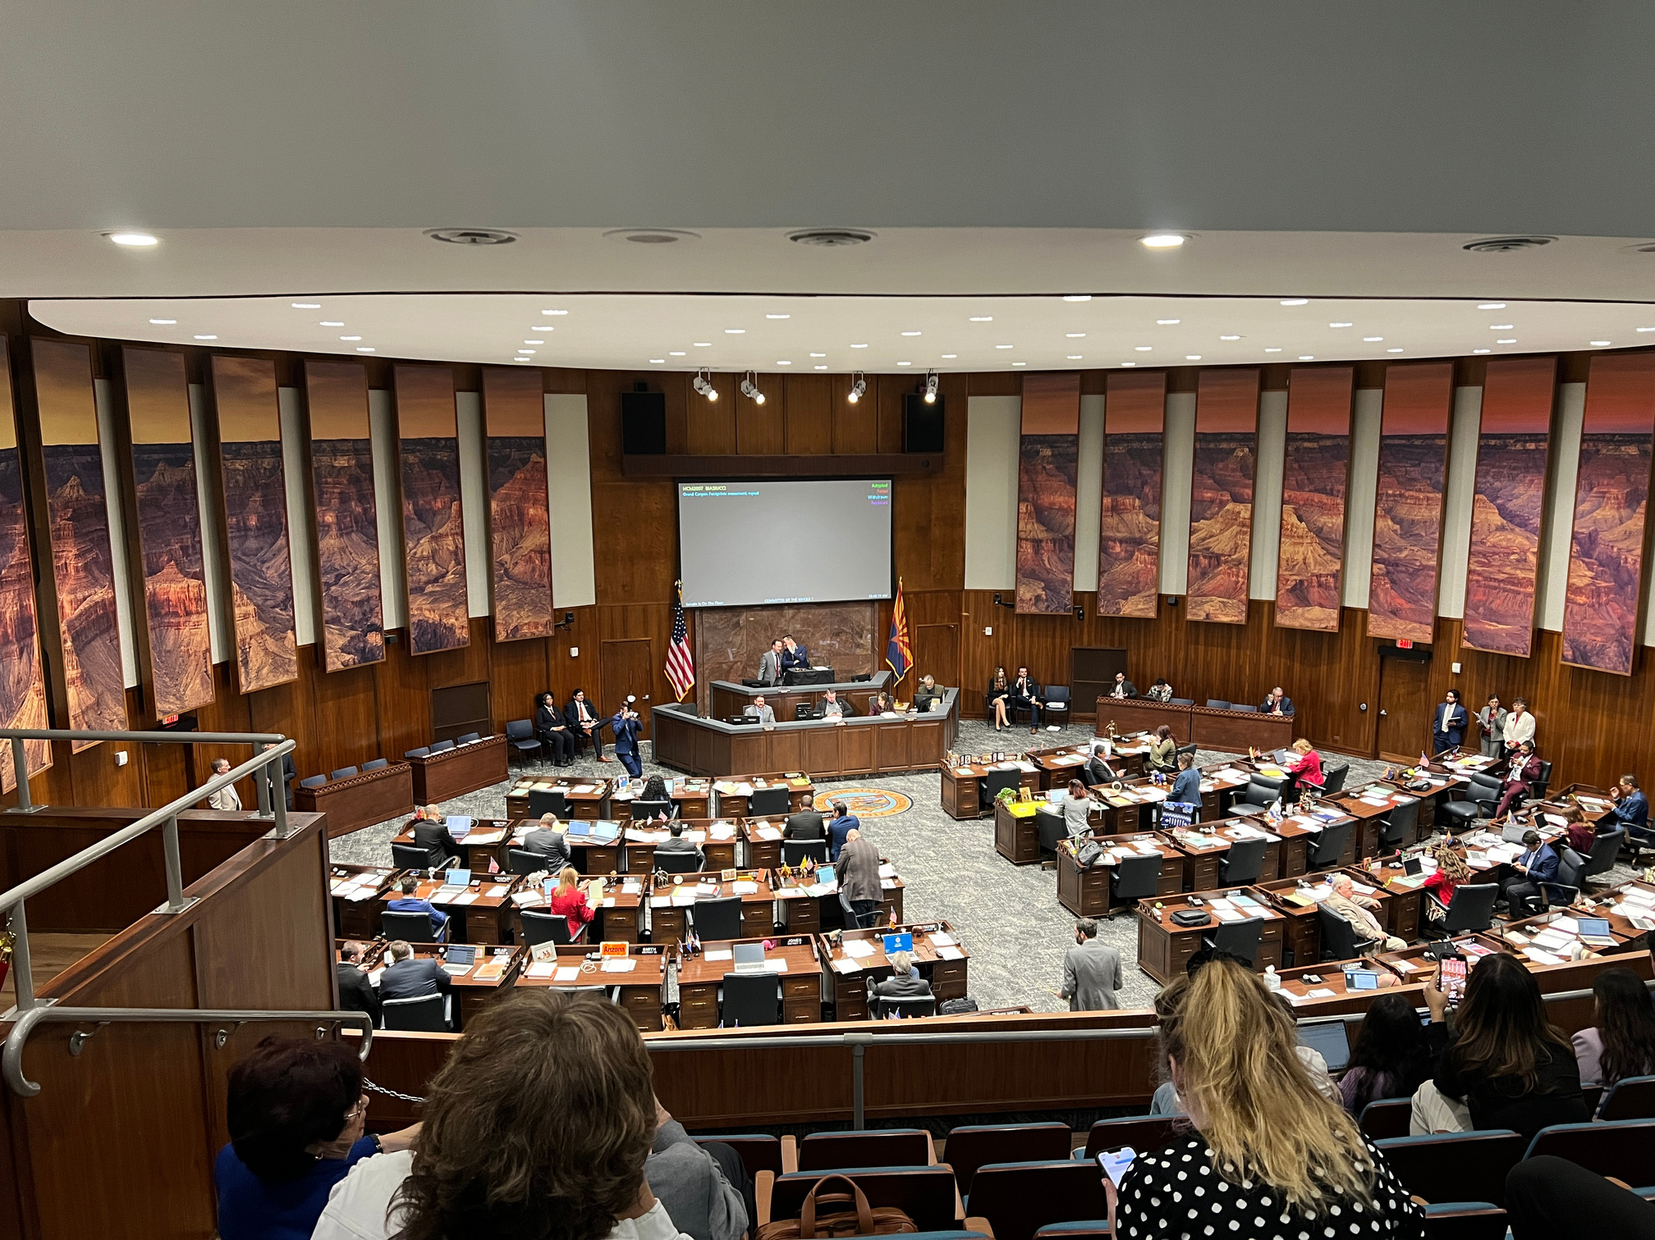
57ᵗʰ Arizona Legislature – Second Regular Session
January 10, 2026 – June 13, 2026
Notes:
6

Slide 5
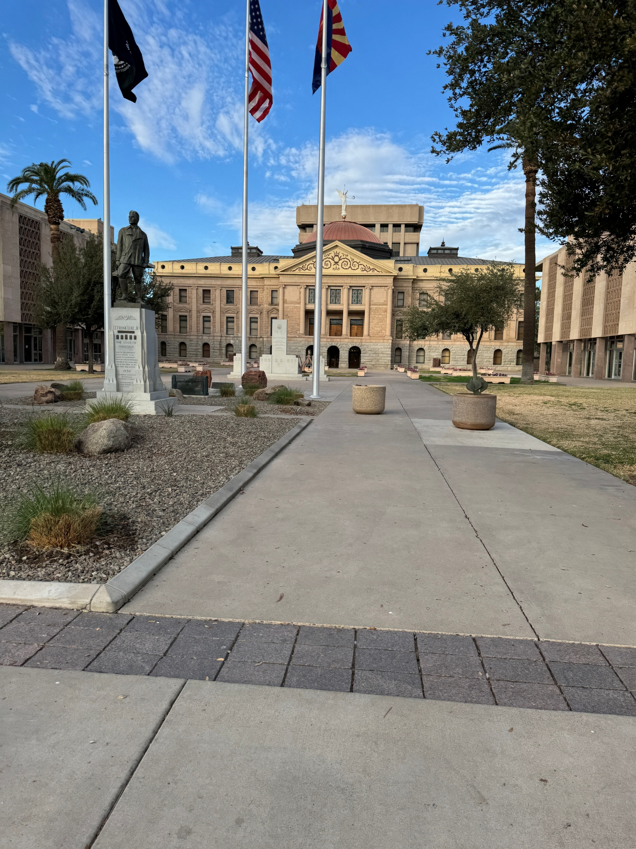
Session by the Numbers
Days of Session:
153
Bills Posted:
2,030
Bills Passed:
415
Bills Vetoed:
151
Bills Signed:
264

Slide 6

2026 Legislature Timeline
Jan 12
First Day of Session
Feb 20
Committee Deadline (originating chamber)
MAR 27
Opposite Chamber Committee Deadline
APR 21
Day 100
May
Break
June 13
Sine Die
Sept 12
General Effective Date

Slide 7
2026 Healthcare Wins
HB2176 health facilities; licensure; complaints; investigations
  Sponsor: Representative Willoughby
    Requires ADHS to notify a licensee of the general nature of a complaint at the start of the investigation.
    Prohibits ADHS from investigating alleged violations that occurred more than 12 months before the complaint was submitted.
    Requires statements of deficiencies to cite the applicable statute or rule for each deficiency.
  Signed by Governor on June 4, 2026 (general effective date)
SB1162 health care institutions; licensing; complaints
  Sponsor: Senator Angius
    The bill establishes the Department of Health Services as the agency responsible for licensing and monitoring health care institutions by explicitly stating its authority directly in statute. Requires departments to review duplicative policies and formulate a plan, with follow-up review every four years.
    Amended to include a definition and outline the role of a Behavioral Health Technician.
  Transmit to the Governor on June 10, 2026 (general effective date)

Slide 8
2026 Healthcare Wins
SB1253 safe haven providers; hospital deliveries
  Sponsor: Senator Mesnard
    Provides clarification to the law that mothers are allowed to relinquish their baby under the law immediately following delivery in a hospital.
  Transmit to the Governor on June 9, 2026 (general effective date)
HB2049 radiation therapy; rural counties
  Sponsor: Representative Bliss
    Authorized the use of particle accelerators for radiation therapy under general supervision in counties with fewer than 400,000 residents or in a critical access hospital.
  Bill signed and became law on June 4, 2026 (emergency clause).
HB2177 AHCCCS; waivers; American Indians; services
  Sponsor: Representative Willoughby
    Requires AHCCCS to annually apply to CMS for waivers or waiver amendments to restore coverage for services eliminated, reduced, or limited since 2010 when provided to American Indian or Alaska Native members.
  Signed by the Governor on April 13, 2026 (general effective date)

Slide 9
2026 Healthcare Wins
SB1253 safe haven providers; hospital deliveries
  Sponsor: Senator Mesnard
    Provides clarification to the law that mothers are allowed to relinquish their baby under the law immediately following delivery in a hospital.
  Transmitted to the Governor on June 9, 2026 (general effective date)
SB1814 (substance use disorder treatment; committee)
  Sponsor: Senator Werner
  Establishes the Substance Use Disorder Treatment Standards and Oversight Committee.
  Signed by the Governor on June 19, 2026
SB1776 (traditional healing services; AHCCCS)
  Sponsor: Senator Gonzales
  Allows AHCCCS and its contractors to provide pilot coverage for traditional healing services for the next three years, subject to CMS approval.
  Bill was added as a budget item and ultimately signed into law.

Slide 10

Director Johnston Confirmed!

Slide 11
What didn’t move forward…
HB2194 claims; prior authorization; denials; contact
  Sponsor: Representative Bliss
    Requires health care insurers to provide a detailed explanation for any denied claim or prior authorization and to include contact information of a person or department who can address questions regarding the denial.
  Bill died in the House Rules committee due to the chair's refusal to move the bill forward.
SB1628 claims denial; prior authorization; reporting
  Sponsor: Senator Angius
    Requires that health plans report claims and prior authorization denial rates to DIFI and the top categories for denials of each.
  Held in the House

Slide 12
What didn’t move forward…
SB1114 (appropriation; behavioral health patient brokering)
  Sponsor: Senator Werner
    Would have appropriated $1 million for investigations relating to behavioral health patient brokering.
  Held in the House
SB1116 (AHCCCS; claims review; behavioral health)
  Sponsor: Senator Werner
    Would have required medical necessity denials for American Indian Health Program behavioral health services to be reviewed and approved by a qualified clinician with at least two years of relevant experience.
  Held in the House
SB1122 (AHCCCS; prior authorization; behavioral health)
  Sponsor: Senator Werner
    Would have restricted AHCCCS from imposing 100% prepayment review on American Indian Health Program behavioral health providers except when the provider is noncompliant with a corrective action plan.
  Held in the House

Slide 13
What didn’t move forward…
SB1171 (AHCCCS; dual enrollment; notice)
  Sponsor: Senator Werner
    Would have required applicants, licensees, owners, and controlling persons of behavioral health facilities to be U.S. citizens or have permanent residency and a valid fingerprint clearance card.
  Vetoed by the Governor – letter cites the bill would harm good healthcare providers
SB1233 (administrative deficiencies; cure period)
  Sponsor: Senator Werner
    Would have required ADHS, AHCCCS, and DES to provide a 72-hour cure period before taking enforcement action against a contracted or licensed facility for administrative deficiencies.
  Vetoed by the Governor – letter cites the bill falls short of the State’s responsibility to the taxpayers to ensure that it safeguards against fraud, waste, and abuse.

Slide 14
What didn’t move forward…
SB1346 (AHCCCS; fee-for-service; claims)
  Sponsor: Senator Werner
    Would have required AHCCCS to notify claimants of administrative deficiencies within 72 hours of receiving a claim and approve or deny the claim within 10 business days after deficiencies are corrected or if none exist.
  Held in the House
SB1611 (American Indian health program; administration)
  Sponsor: Senator Werner
    Would have required AHCCCS to contract with an administrative services organization for American Indian Health Program care management and program integrity while preserving the Program's fee-for-service structure and tribal oversight.
  Held in the House

Slide 15

The Final Budget

Slide 16
FY 2027 State Budget
Critical Access Hospitals (CAHs):
  A one-time funding increase continues at $4.4 million. This funding draws down federal matching dollars and replenishes the supplemental pool for eligible rural hospitals.
AHCCCS & DES implementation funding:
  One-time allocations of $51.5 million (AHCCCS) and $10.8 million (DES) to implement Public Law 119-21.
Traditional healing services pilot:
  The budget includes a 3-year pilot program to cover traditional healing services, contingent on federal approval.

Slide 17
Arizona FY2027
Graduate Medical Education (GME): More than $4 million was preserved following sustained advocacy by physician organizations and healthcare stakeholders to maintain physician training investments.
988 Behavioral Health Crisis Line: Includes $4 million to AHCCCS to support continued operation of Arizona’s Behavioral Health Crisis Services Hotline (9-8-8).
Maternal & pediatric behavioral health: Includes up to $1.2 million through the University of Arizona General Fund allocation to operate the Arizona Perinatal and Pediatric Psychiatry Access Line, expanding provider access to behavioral health consultation.
Tax conformity: Budget provisions conform with all applicable HR1 federal tax provisions for the current fiscal year and FY2026. The budget also adopts select provisions for FY2027 and beyond, with an estimated state General Fund impact of approximately $281 million beginning in FY2027.

Slide 18
Arizona FY2027
Rural Health Transformation Fund
  The FY2027 budget establishes a new fund under AHCCCS to administer federal Rural Health Transformation Program grants.
  Before the executive branch may expend any grant funding to advance its outlined initiatives, AHCCCS must hold three public meetings to gather comments and submit a report to the Joint Legislative Budget Committee detailing its expenditure plan.

Slide 19

2026 Election Cycle

Slide 20

Ballot Measures
10 ballot measures passed this year alone.
3 carried over from previous session.
Unclear of where leadership will land on which measures move forward on the ballot.

Slide 21

Dates that matter
Primary Election:
  June 6 - military and overseas ballots are mailed
  June 22 - voter registration deadline
  June 24 - ballots mailed and early voting begins
  July 10 - last day to request a replacement ballot by mail
  July 14 - Last day to mail back your ballot
  July 21 - ELECTION DAY!
General Election:
  September 19 - Military and overseas ballots mailed
  October 5 - Voter registration deadline
  October 7 - Ballots mailed and early voting begins
  October 23 - Last day to request a replacement ballot by mail
  October 27 - Last day to mail back your ballot
  November 3 - ELECTION DAY!

Slide 22

Thank You!
Email: djohnson@azhha.org
Phone: 623-680-7198
Notes:
19

